Slide 1

Database Information Management Updating records using PDO in PHP
KF5002 Web Programming
2020/21

Slide 2
General steps to update records
Generate & display a form
Form action links to script to process form
Process script:
Retrieve variables from the request
Check variables are valid
If not valid then
Give error message
else
sanitise those variables
Connect to server
Construct SQL query
Execute query
Link back…
Note the steps are similar to those for inserting
Note also that for clarity on the slides we won’t repeat all of the checking, sanitising and linking back steps that you looked at earlier – you would need to do them of course

Slide 3
Reminder: updating data using SQL
UPDATE tablename SET columnname=?? [WHERE <expression>];
The ‘where’ clause is optional
Table: todo
id | userID | Item
1 | 3 | Wash car
2 | 1 | Write lecture
3 | 1 | Mark exams
4 | 5 | Run marathon
5 | 2 | Call home
6 | 4 | Buy pens
e.g. UPDATE todo SET Item= 'Reply to emails'
UPDATE todo SET Item= 'Mark 100 exams' where id = 3
UPDATE todo SET Item= 'Mark 100 exams', userID = 4 where id = 3

Slide 4
Updating data using SQL - exercise
Using the table below, write the SQL update statement that changes the surname to ‘Stevenson’ for the student with studentID w123456789.
Table: srs_student
studentID | forename | surname | programme | level
w123456789 | Sally | Stevenson | BSc Computing | 5
w234178090 | Joe | Bloggs | BA Graphic Design | 4
UPDATE srs_student
SET surname= 'Stevenson'
WHERE studentID = 'w123456789'

Slide 5
Updating data using SQL - exercise
Using the table below, write the SQL update statement that changes the forename to 'Joseph' and the programme to 'BSc Computer Science' for the student with studentID w234178090.
Table: srs_student
studentID | forename | surname | programme | level
w123456789 | Sally | Stevenson | BSc Computing | 5
w234178090 | Joe | Bloggs | BA Graphic Design | 4
UPDATE srs_student
SET forename= 'Joseph', programme='BSc Computer Science'
WHERE studentID = 'w234178090'

Slide 6
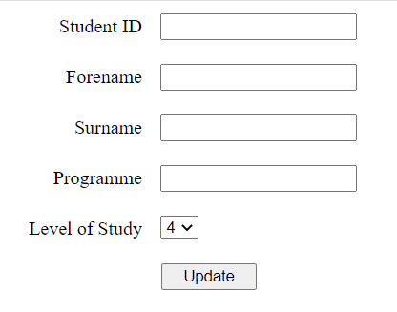
Updating a record – example form
<form method="post" action="updateStudent.php">
<label>Student ID <input type="text" name="studentID"></label>
<label>Forename<input type="text" name="forename"></label>
<label>Surname<input type="text" name=“surname"></label>
<label>Programme <input type="text" name="programme"></label>
<label> Level of Study
<select name="level">
<option value="4">4</option>
<option value="5">5</option>
<option value="6">6</option>
</select></label>
<input type="submit" value="Update">
</form>
The form collects the new field values and passes them as parameters to the server
A php script will then access the parameter data and use it to update a record in the srs_student table
Notes:
We could use method ‘get’ for testing

Slide 7
The update process
Retrieve the variables.
$studentID = isset($_REQUEST['studentID']) ? $_REQUEST['studentID'] : null;
$forename = isset($_REQUEST['forename']) ? $_REQUEST['forename'] : null;
$surname = isset($_REQUEST['surname']) ? $_REQUEST['surname'] : null;
$programme = isset($_REQUEST['programme']) ? $_REQUEST['programme'] : null;
$level = isset($_REQUEST['level']) ? $_REQUEST['level'] : null;
Remember you would validate and sanitise before continuing
Connect to the server (as you have already learnt to do using PDO)
Construct the sql query, but using the retrieved variables:
$updateSQL = "UPDATE srs_student SET
forename = '$forename',
surname = '$surname',
programme = '$programme',
level = $level
WHERE studentID = '$studentID'";
Execute the query
$dbConn->exec($updateSQL);
Substitute the values of the variables (the data from the web form)

Slide 8
Reminder: improving the update process
We could allow the user to select a record to modify from a list of records and then have the current details for that record displayed in a pre-populated form ready to change

Slide 9
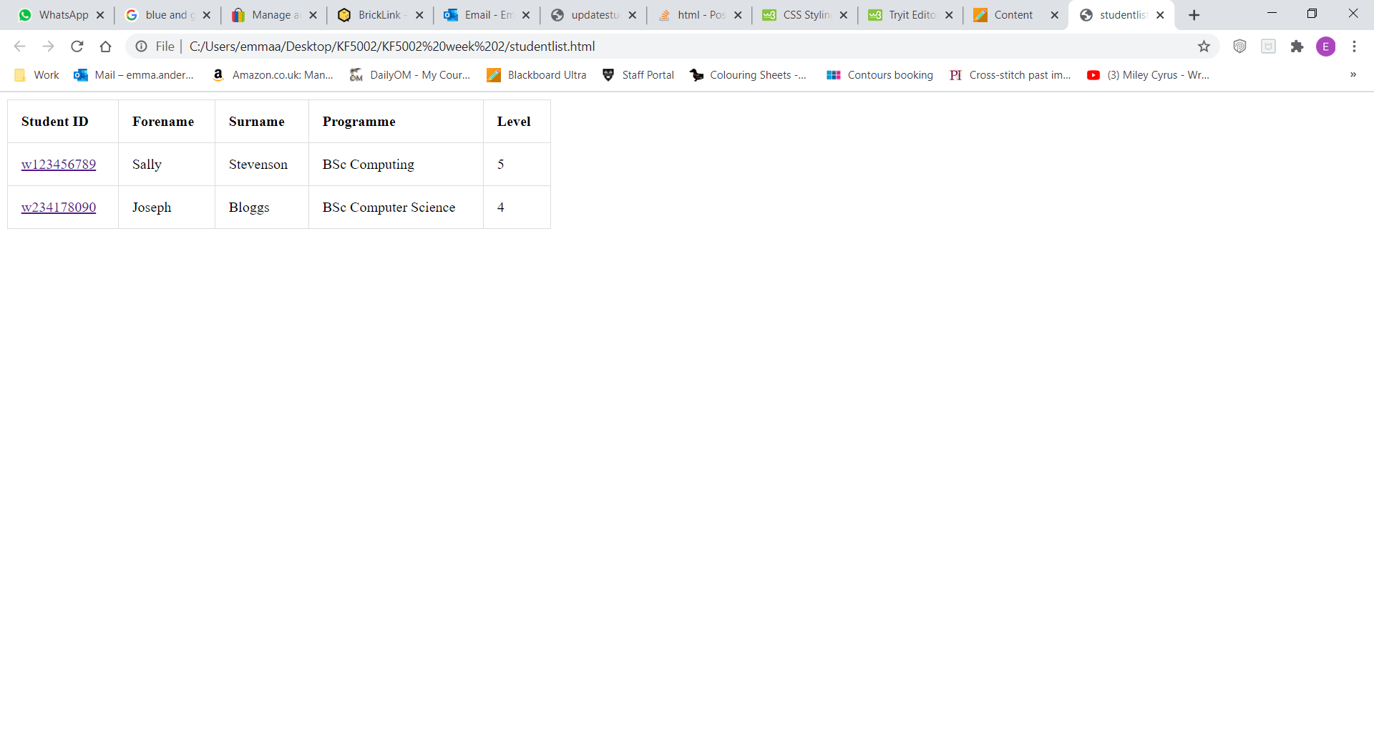
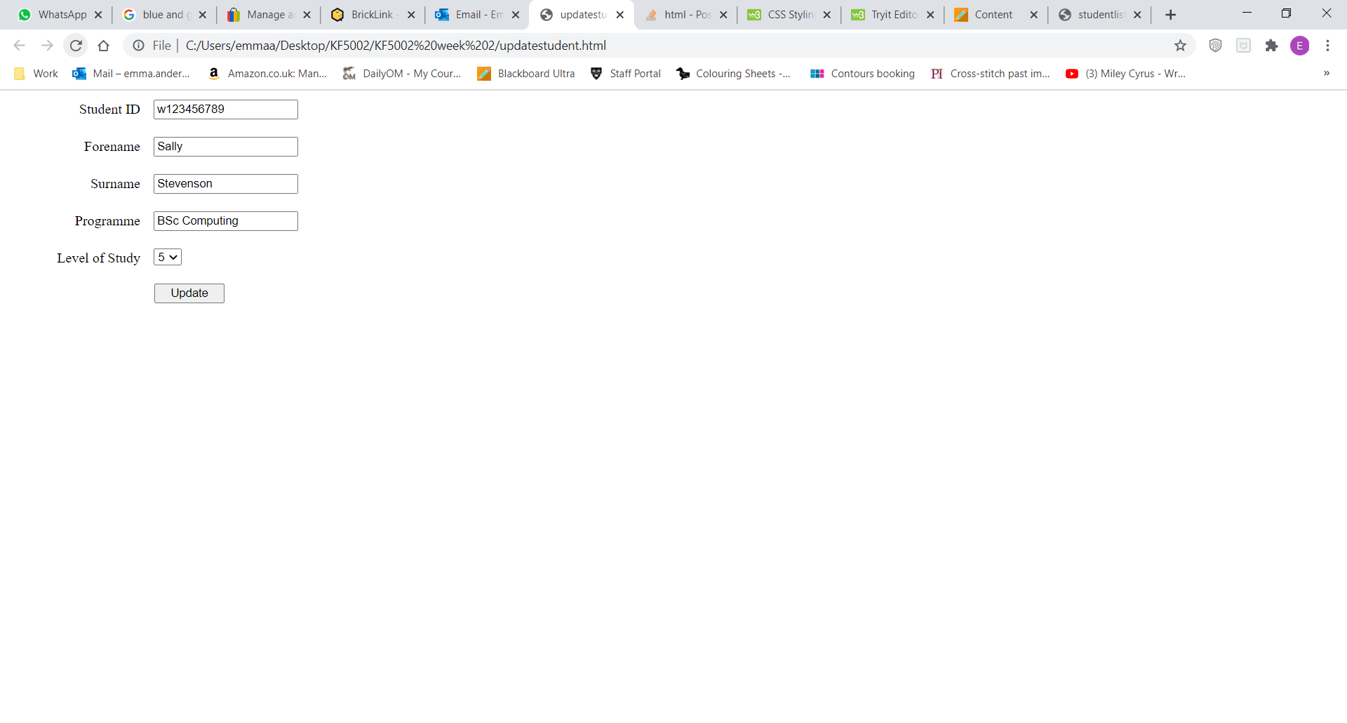
Updating using hyperlinks – process overview
When clicked a link passes the studentID of the selected record (we always link on the primary key) to the server via a query string where a script can use it to create a form that displays the current full details of the selected record
On submission the modified details are sent to the server where an update script can use them to update the specified record
PHP update script

Slide 10
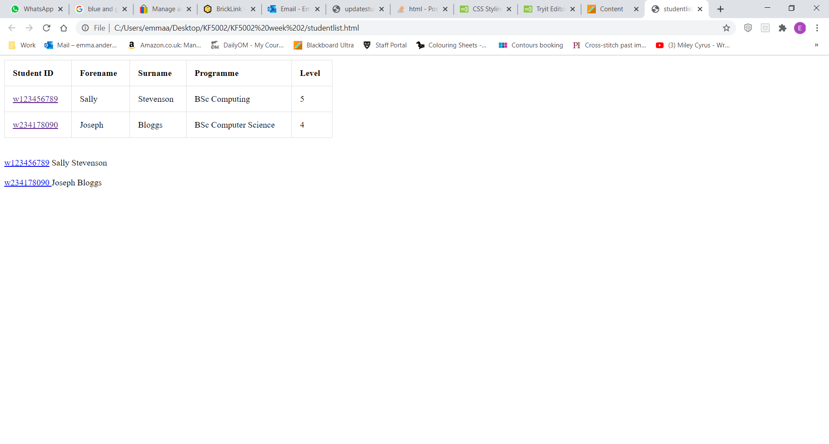
The hyperlink list
<a href='updateStudentForm.php?studentID=w123456789'>w123456789</a>Sally Stevenson ..
<a href= 'updateStudentForm.php?studentID=w234178090'> w234178090 </a>Joseph Bloggs ..
Which method for passing the name and value pairs is being used here?
Options for creating the hyperlinks?
‘pre-code’ them or
dynamically build them by querying the srs_student table and generating the required HTML for the links using the query results.
This would make sure that the list is up to date

Slide 11
Dynamically building the hyperlinks
How do we dynamically build the list of hyperlinks?
Query the database to get the full set of student records
Iterate through them and echo one hyperlink for each to the browser

Slide 12
Building the hyperlinks - querying part
Connect to the server using PDO (as you have already learnt to do using the getConnection() function) storing the connection details in a variable named $dbConn
Construct the sql query we need
$sqlQuery = "SELECT studentID, forename, surname, programme, level
FROM srs_student";
Execute the query
$queryResult = $dbConn->query($sqlQuery);

Slide 13
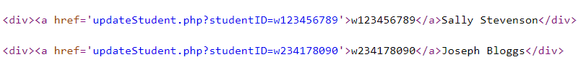
Building the hyperlinks – iterate
Iterate over (loop through) the query results
while($rowObj = $queryResult->fetchObject()){
echo "<div>
<a href=
'updateStudentForm.php?studentID={$rowObj->studentID}'> {$rowObj->studentID}</a>";
echo "{$rowObj->forename} {$rowObj->surname}</div>\n\n";
}
For each record, create a link to an update form with its studentID in a query string

Slide 14
The update form with current details (1) - exercise
Think about how you might attempt the code for the steps below:
Get the studentID passed by the hyperlink.
$studentID =
Construct the SQL query to retrieve the full details of the record for the given studentID.
$sqlQueryStudent =
Execute the query
$queryResultStudent =
Fetch and store the record returned by the query
$studentRowObj =

Slide 15
The update form with current details (1) - answer
Get the studentID passed by the hyperlink.
$studentID = $_GET['studentID'];
Construct the SQL query to retrieve the full details of the record for the given studentID.
$sqlQueryStudent = "select forename, surname, programme, level from srs_student where studentID = '$studentID'";
Execute the query
$queryResultStudent = $dbConn->query($sqlQueryStudent);
Fetch and store the record returned by the query
$studentRowObj = $queryResultStudent->fetchObject();

Slide 16
The update form with current details (2)
Create a form and pre-populate it by setting the values we now have for studentID, forename, surname, programme and level as defaults (using the value attribute for the input)
echo "<form method='get' action='updateStudent.php'>
<label>Student ID<input type='text' name='studentID' value='$studentID'></label>
<label>Forename<input type='text' name='forename' value='{$studentRowObj->forename}'></label>
<label>Surname<input type='text' name='surname' value='{$studentRowObj->surname}'></label>
// Code for programme and level would go here
<input type='submit' value='Update'>
</form>";

Slide 17
The populated update form
Example: the update form produced if record w123456789 is selected
The user could now modify this record
Clicking ‘Update’ would call an appropriate PHP script, e.g. updateStudent.php (with SQL UPDATE code in it) to modify the database
Note that here we are displaying the default (currently chosen) level of study. Think about how you could do that

Slide 18
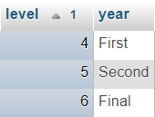
Creating a select list for update - exercise
When updating an attribute which has a fixed set of options to choose from, the select (dropdown) list must show all options and ‘preselect’ the current one.
Firstly how would we create a dropdown of all the levels from the srs_level table just using HTML?
The HTML to do this is:
<select name='level'>
<option value= '4'>4</option>
<option value= '5'>5</option>
<option value= '6'>6</option>
</select>
srs_level table

Slide 19
Creating a select list for update (2)
Now that we understand the HTML we want to generate, how can we create the list of levels from the srs_level table dynamically using PHP and SQL?
1. First, create a sql statement selecting all categories:
$sqlLevel = "select level from srs_level
order by level";
$queryResultLevel = $dbConn->query($sqlLevel);

Slide 20
Creating a select list for update (3)
Execute and iterate displaying each option, using php and echo:
echo "<select name='level'>";
while ($currentLevel = $queryResultLevel->fetchObject()) {
echo "<option value='{$currentLevel->level}'> {$currentLevel->level} </option>";
}
echo "</select>";
The <select> tag must not appear in the while loop. Why?
INTENDED OUTPUT
<select name='level'>
<option value= '4'>4</option>
<option value= '5'>5</option>
<option value= '6'>6</option>
</select>

Slide 21
Creating a select list – pre-select option
To pre-select the correct option you add the ‘selected’ attribute inside the <option>.
We pre-select the option whose level matches the level we already have for the student being updated.
Think about how you might do this. Which programming structure(s) would you need?
INTENDED OUTPUT
<select name='level'>
<option value= '4'>4</option>
<option value= '5’ selected>5</option>
<option value= '6'>6</option>
</select>
Notes:
echo "<select name='level'>"
while ($currentLevel= $queryResultLevel->fetchObject()) {
if ($studentRowObj->level == $currentLevel>level) { $selected = 'selected'; } else { $selected = ''; } echo "<option $selected value=' {$currentLevel->level} ‘>{$currentLevel>level}</option>\n";
}

Slide 22
Creating a select list – pre-select option
This resultset object contains all the columns (as attributes) for that specific student row
$studentRowObj = $queryResultStudent->fetchObject();
$sqlLevel = "select level from
srs_level order by level";
$queryResultLevel = $dbConn->query($sqlLevel);
echo "<label>Level of Study<select name='level'>";
while ($currentLevel = $queryResultLevel->fetchObject()) {
if ($studentRowObj->level == $currentLevel->level) { $selected = 'selected'; }
else { $selected = ''; }
echo "<option value='{$currentLevel->level}' $selected> {$currentLevel->level}</option>";
}
echo "</select></label>";
INTENDED OUTPUT
<select name='level'>
<option value= '4'>4</option>
<option value= '5’ selected >5</option>
<option value= '6'>6</option>
</select>
Notes:
echo "<select name='level'>"
while ($currentLevel= $queryResultLevel->fetchObject()) {
if ($studentRowObj->level == $currentLevel>level) { $selected = 'selected'; } else { $selected = ''; } echo "<option $selected value=' {$currentLevel->level} ‘>{$currentLevel>level}</option>\n";
}

Slide 23
Review / Summary
To manage (add, update etc.) MySQL database records via a web based system we need appropriate web forms and to construct and execute appropriate SQL queries using PDO query(), exec() and fetchObject().
You can create interfaces that allow the user to
Select a record to modify (or perhaps to delete) from a list of records stored in a database table
Display the current field values of a selected record in an update web form (to help the user)

